Slide 1
Novice Bootcamp
Fall 2021
DAY 1
Princeton Debate Panel

Slide 2
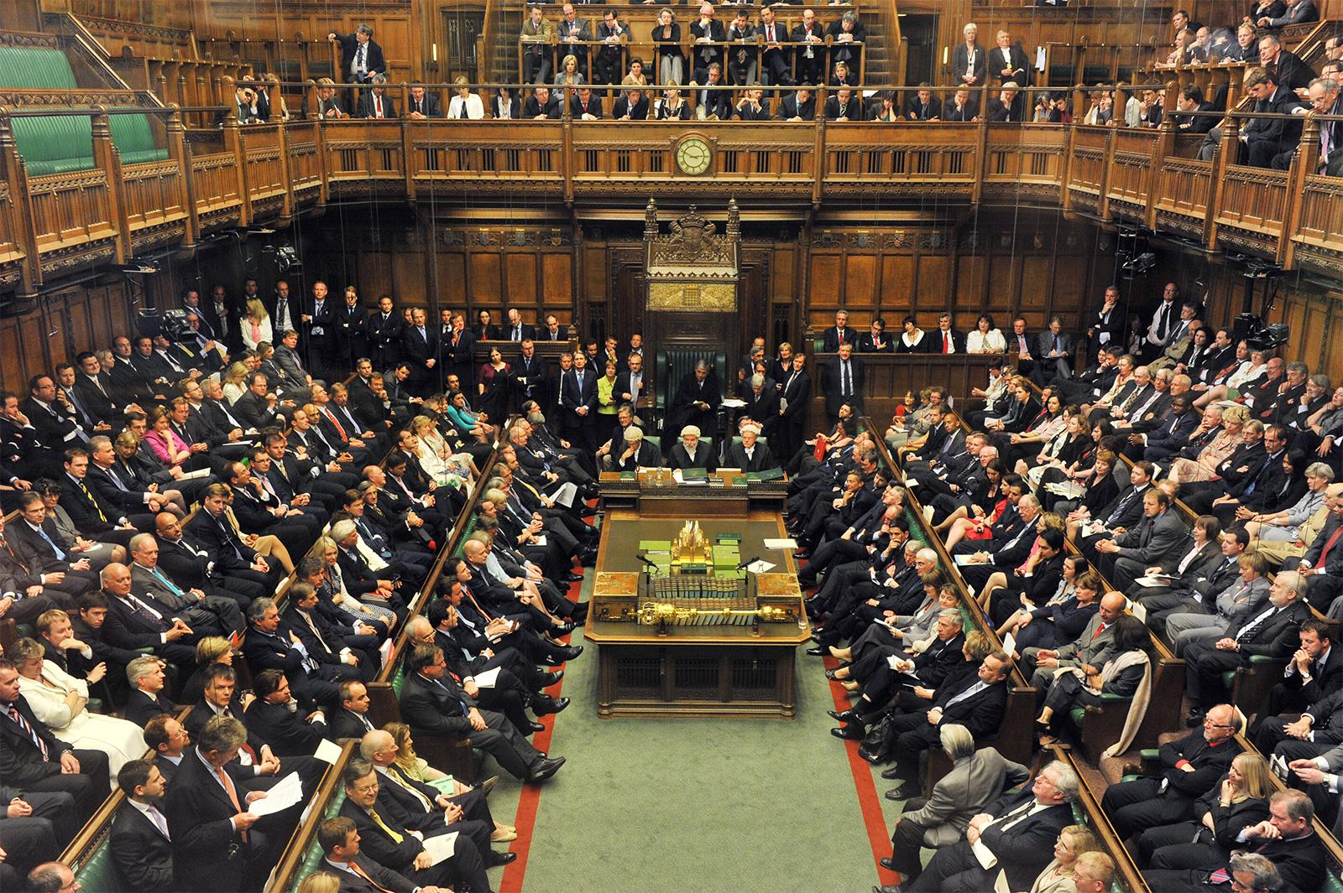
Types of Debate
American Parliamentary (APDA)
Compete with a partner
2 teams per round
CASES or MOTIONS
No evidence
British Parliamentary (BP)
Compete with a partner
4 teams per round
Only MOTIONS
No evidence
???

Slide 3
APDA/BP Motions
Somebody else tells you what to debate
Like tryouts, without the choice
You get 15 minutes to prepare
The government team has to debate the spirit of the motion
APDA Cases
The government team chooses the topic (or “case”)
No preparation time
The government team defines the boundaries of the debate

Slide 4
Examples of Motions
This House believes that governments should abandon the strategy of "decapitation" in fighting terrorism.
This House regrets the idolization of people considered to be "geniuses".
This House would abolish the Olympic Games.

Slide 5
What are cases?
Government chooses the motion/“case”
Also sets the scope of the debate
Can caveat where debate takes place, what opp has to defend, and what issues are up for debate
Can offer “opp choice”
Government has a burden to share the necessary information to debate the case
Opp gets no prep time

Slide 6
What does this look like?
Government says case statement/necessary background
Q & A with opposition team (timed)
What are you trying to achieve on opp?
Get info if you’re lost
Get government to clarify the extent of the debate/make concessions
Buy time to write your speech (BAD)
NOTE: be careful!

Slide 7
Run anything… with a few restrictions!
Nothing “tight” -- obviously true statements, morally reprehensible opps, etc.
Ex. Racism is bad, legalize marijuana, etc
Nothing too “spec” -- really specific facts that an opposition team could not reasonably be expected to know
Nothing about a super obscure war, weird complicated physics, etc.
Nothing true in the status quo -- you cannot advocate for a policy that is already in place
Ways around this are to think of a place that doesn’t have that policy
Abortion should be legal in Canada

Slide 8
How can you oppose - brief summary
Straight opp
Defend the opposite of case statement
Counter-case
Propose an alternative to the case
Is mutually exclusive from gov case
Is as or more plausible than the case
Tight call
Claim motion is unopposable
Function of two sides switch - you have to defend why that case is TOO winnable
“Spec call”
Applies to whole debate OR arguments

Slide 9
The structure of APDA case rounds
Government | Opposition
Reading of case statement - 10 seconds - 1 min
Points of clarifications (POCs) - up to 15 mins | Points of clarifications (POCs) - up to 15 mins
Prime Minister Constructive (PMC) - 7 mins + 30 secs
 | Leader of the Opposition(LOC) - 8 mins + 30 secs
Member of Government (MG) - 8 mins + 30 secs
 | Member of the Opposition (MO) - 8 mins + 30 secs
 | Leader of the Opposition (LOR) - 4 mins + 30 secs
Prime Minister (PMR) - 5 mins + 30 secs

Slide 10
Prime Minister’s Constructive (PMC)
7 minutes 30 seconds maximum
Debate setup
Define briefly the terms of the debate if necessary
Stop the timer
Opposition can briefly ask clarifying questions
Restart the timer
Give 2-3 arguments for the motion
Much like tryouts!

Slide 11
Sample setup dialogues
This House Would Pay Reparations to African Americans
Example 1:
PM: reads case statement. (off-time)
“Any questions?”
MO: “No questions.”
PM: *starts timer* “ Our first argument is…”
Example 2:
PM: reads case statement. (off-time)
“Any questions?”
LO: “What form are these reparations going to take?”
PM: “We’re going to give them cash handouts.”
MO: “Cool. We don’t have any more questions.”
PM: “Great.” *starts timer* ...

Slide 12
Leader of the Opposition’s Constructive (LOC)
8 minutes 30 seconds maximum
If needed, give setup for opposition case
Same procedure as for PMC
Pause timer, give gov chance to ask questions
Give 2-3 arguments (~5 minutes)
Respond to PMC’s arguments (rest of time)

Slide 13
Member of Government (MG)
8 minutes 30 seconds maximum
Rebuild your case
The LO will have just given some responses: explain why they’re wrong
Optional: Can add a bit of nuance/extra warranting/impacting
Respond to the opposition case
Optional: add an extra argument

Slide 14
Member of Opposition (MO)
8 minutes 30 seconds maximum
Rebuild your case
The MG will have just given some responses: explain why they’re wrong
Optional: Can add a bit of nuance/extra warranting/impacting
Respond to the opposition case
Add new responses
Defend the LO’s initial responses
Optional: add an extra argument

Slide 15
Leader of the Opposition’s Rebuttal (LOR)
4 minutes 30 seconds maximum
NO new material except weighing
Synthesize the round in the most favourable light for your team
Examples
“Gov argues X. Even if that’s true, our argument that Y is more important for 3 reasons…”
“Comparing our claims on this issue to theirs, you should believe ours because…”

Slide 16
Prime Minister’s Rebuttal (PMR)
5 minutes 30 seconds maximum
Only new material permitted is rebuttal to MO/LOR arguments
Synthesize the round in the most favourable light for your team

Slide 17
Also,
More debate mechanics

Slide 18
Flowing is how you can keep track of a round
The method of taking notes during the debate
Use two sheets of paper -- one for the on-case and one for the off-case
Orient the paper vertically or horizontally and have each speech be a narrow column
Have responses be written next to the argument they’re responding to
Use two colors of pens to have it be easy to read
Use abbreviations -- you don’t have time to write out full words

Slide 19
Example Flow (On case)
PM
Arg 1
Arg 2
LO
Response
Response
MG
Response
Response
MO
Response
Response

Slide 20
Example Flow (Off case)
LO
Arg 1
Arg 2
MG
Response
Response
MO
Response
Response

Slide 21
How are debates judged?
The criteria for victory are up for success
What distribution of impacts we should care about?
What other moral principles matter?
Evaluate ONLY the argument
NOT “I think I agree with the gov”
NOT “I found this argument a bit implausible”
Will disregard blatantly untrue/underwarranted arguments
Judges evaluate only the arguments -- they don’t judge based on their personal opinion or who sounds prettier
Judges are reasonable -- if you claim the sky is red, they aren’t going to give you credit for it even if the other team doesn’t respond

Slide 22
The End

